Slide 1
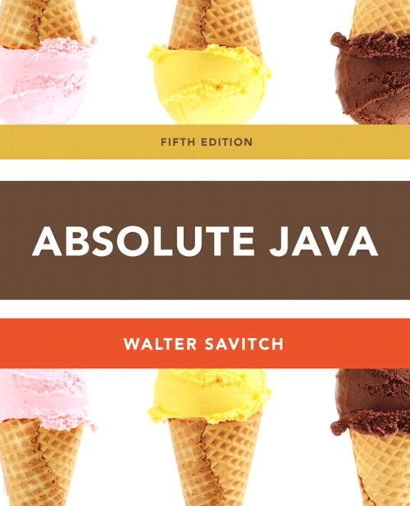
Chapter 1
Section 1.1 Introduction to Java
Slides prepared by Rose Williams, Binghamton University
Kenrick Mock, University of Alaska Anchorage

Slide 2
Introduction To Java
Most people are familiar with Java as a language for Internet applications
We will study Java as a general purpose programming language
The syntax of expressions and assignments will be similar to that of other high-level languages
Details concerning the handling of strings and console output will probably be new

Slide 3
Origins of the Java Language
Created by Sun Microsystems team led by James Gosling (1991)
Originally designed for programming home appliances
Difficult task because appliances are controlled by a wide variety of computer processors
Team developed a two-step translation process to simplify the task of compiler writing for each class of appliances

Slide 4
Origins of the Java Language
Significance of Java translation process
Writing a compiler (translation program) for each type of appliance processor would have been very costly
Instead, developed intermediate language that is the same for all types of processors : Java byte-code
Therefore, only a small, easy to write program was needed to translate byte-code into the machine code for each processor

Slide 5
Origins of the Java Language
Patrick Naughton and Jonathan Payne at Sun Microsystems developed a Web browser that could run programs over the Internet (1994)
Beginning of Java's connection to the Internet
Original browser evolves into HotJava
Netscape made its Web browser capable of running Java programs (1995)
Other companies follow suit

Slide 6
Objects and Methods
Java is an object-oriented programming (OOP) language
Programming methodology that views a program as consisting of objects that interact with one another by means of actions (called methods)
Objects of the same kind are said to have the same type or be in the same class

Slide 7
Terminology Comparisons
Other high-level languages have constructs called procedures, methods, functions, and/or subprograms
These types of constructs are called methods in Java
All programming constructs in Java, including methods, are part of a class

Slide 8
Java Application Programs
There are two types of Java programs: applications and applets
A Java application program or "regular" Java program is a class with a method named main
When a Java application program is run, the run-time system automatically invokes the method named main
All Java application programs start with the main method

Slide 9
Applets
A Java applet (little Java application) is a Java program that is meant to be run from a Web browser
Can be run from a location on the Internet
Can also be run with an applet viewer program for debugging
Applets always use a windowing interface
In contrast, application programs may use a windowing interface or console (i.e., text) I/O

Slide 10
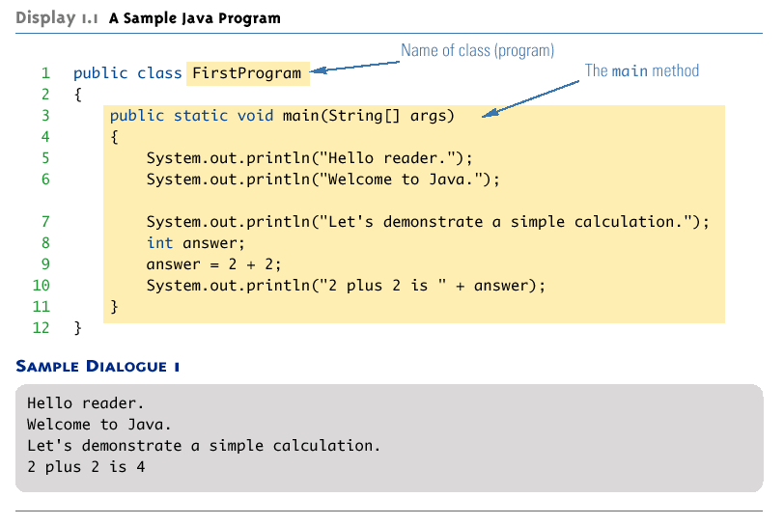
A Sample Java Application Program

Slide 11
System.out.println
Java programs work by having things called objects perform actions
System.out: an object used for sending output to the screen
The actions performed by an object are called methods
println: the method or action that the System.out object performs

Slide 12
System.out.println
Invoking or calling a method: When an object performs an action using a method
Also called sending a message to the object
Method invocation syntax (in order): an object, a dot (period), the method name, and a pair of parentheses
Arguments: Zero or more pieces of information needed by the method that are placed inside the parentheses
System.out.println("This is an argument");

Slide 13
Variable declarations
Variable declarations in Java are similar to those in other programming languages
Simply give the type of the variable followed by its name and a semicolon
int answer;

Slide 14
Using = and +
In Java, the equal sign (=) is used as the assignment operator
The variable on the left side of the assignment operator is assigned the value of the expression on the right side of the assignment operator
answer = 2 + 2;
In Java, the plus sign (+) can be used to denote addition (as above) or concatenation
Using +, two strings can be connected together
System.out.println("2 plus 2 is " + answer);

Slide 15
Computer Language Levels
High-level language: A language that people can read, write, and understand
A program written in a high-level language must be translated into a language that can be understood by a computer before it can be run
Machine language: A language that a computer can understand
Low-level language: Machine language or any language similar to machine language
Compiler: A program that translates a high-level language program into an equivalent low-level language program
This translation process is called compiling

Slide 16
Byte-Code and the Java Virtual Machine
The compilers for most programming languages translate high-level programs directly into the machine language for a particular computer
Since different computers have different machine languages, a different compiler is needed for each one
In contrast, the Java compiler translates Java programs into byte-code, a machine language for a fictitious computer called the Java Virtual Machine
Once compiled to byte-code, a Java program can be used on any computer, making it very portable

Slide 17
Byte-Code and the Java Virtual Machine
Interpreter: The program that translates a program written in Java byte-code into the machine language for a particular computer when a Java program is executed
The interpreter translates and immediately executes each byte-code instruction, one after another
Translating byte-code into machine code is relatively easy compared to the initial compilation step

Slide 18
Program terminology
Code: A program or a part of a program
Source code (or source program): A program written in a high-level language such as Java
The input to the compiler program
Object code: The translated low-level program
The output from the compiler program, e.g., Java byte-code
In the case of Java byte-code, the input to the Java byte-code interpreter

Slide 19
Class Loader
Java programs are divided into smaller parts called classes
Each class definition is normally in a separate file and compiled separately
Class Loader: A program that connects the byte-code of the classes needed to run a Java program
In other programming languages, the corresponding program is called a linker

Slide 20
Compiling a Java Program or Class
Each class definition must be in a file whose name is the same as the class name followed by .java
The class FirstProgram must be in a file named FirstProgram.java
Each class is compiled with the command javac followed by the name of the file in which the class resides
javac FirstProgram.java
The result is a byte-code program whose filename is the same as the class name followed by .class
FirstProgram.class

Slide 21
Running a Java Program
A Java program can be given the run command (java) after all its classes have been compiled
Only run the class that contains the main method (the system will automatically load and run the other classes, if any)
The main method begins with the line:
public static void main(String[ ] args)
Follow the run command by the name of the class only (no .java or .class extension)
java FirstProgram

Slide 22
Syntax and Semantics
Syntax: The arrangement of words and punctuations that are legal in a language, the grammar rules of a language
Semantics: The meaning of things written while following the syntax rules of a language

Slide 23
Tip: Error Messages
Bug: A mistake in a program
The process of eliminating bugs is called debugging
Syntax error: A grammatical mistake in a program
The compiler can detect these errors, and will output an error message saying what it thinks the error is, and where it thinks the error is

Slide 24
Tip: Error Messages
Run-time error: An error that is not detected until a program is run
The compiler cannot detect these errors: an error message is not generated after compilation, but after execution
Logic error: A mistake in the underlying algorithm for a program
The compiler cannot detect these errors, and no error message is generated after compilation or execution, but the program does not do what it is supposed to do

